Slide 2
New Technology Section

Slide 3
Objectives
Understanding New Technology Section
Clinical examples for better understanding
Knowledge Check
Exercises
Coding Clinic

Slide 4
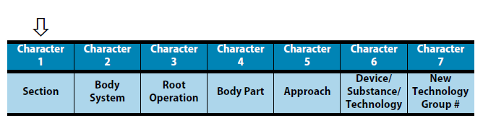
New Technology Section
New Technology (X) is a section added to ICD-10-PCS beginning October 1, 2015.
This section provides a place for codes that uniquely identify procedures requested via the New Technology Application Process or that capture other new technologies not currently classified in ICD-10-PCS.
Section X does not introduce any new coding concepts or unusual guidelines for correct coding.
The Character 7, which instead of qualifier, indicates the New Technology Group year number.

Slide 5

New Technology Section
New Technology (X) section codes are found by looking in the ICD-10-PCS index or by going directly to the New Technology (X) tables. In the index, the name of the new technology device, substance, or technology is included as a main term. In addition, all codes in New Technology (X) section are listed under the main term New Technology. The index entries for ceftazidime-avibactam are as follows:

Slide 6
New Technology Section
New Technology Character Meanings
Character 1: Section- Always New Technology (X)
Character 2: Body System
Currently there are 10 body system values:
Cardiovascular System (2)
Skin, Subcutaneous Tissue, Fascia and Breast (H)
Muscles, Tendons, Bursae and Ligaments (K)
Bones (N)
Joints (R)
Urinary System (T)

Slide 7
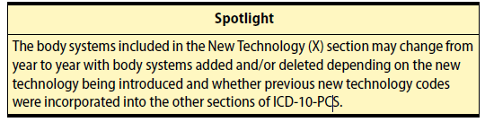
New Technology Section
Male Reproductive (V)
Anatomical Regions (W)
Physiological Systems (X)
Extracorporeal (Y)

Slide 8
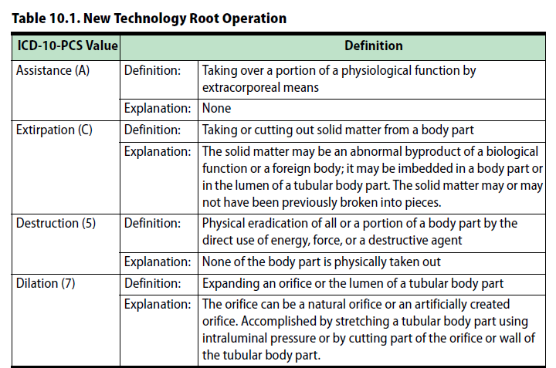
New Technology Section
Character 3: Root Operation
There are 10 root operations currently-

Slide 9
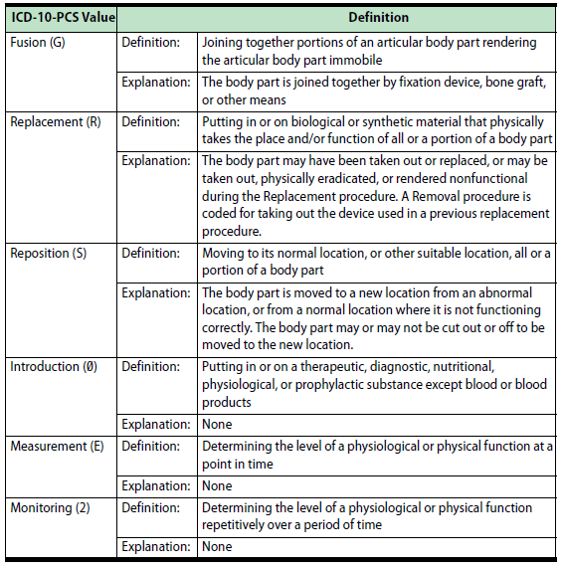
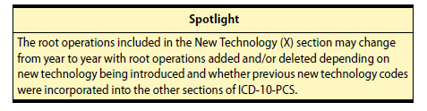
New Technology Section
Character 3: Root Operation

Slide 10
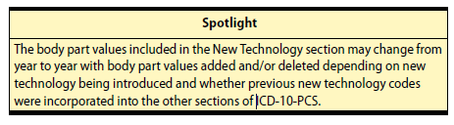
New Technology Section
Character 4: Body Part
The fourth character body part values have a specific and direct relationship to the body system (character 2) value.
Character 5: Approach
Currently there are 5 approach values: Open (0), percutaneous (3), Percutaneous Endoscopic (4), Via Natural or Artificial Opening Endoscopic (8), and External (X). The definitions remain the same as in the Medical and Surgical Section (0)

Slide 11
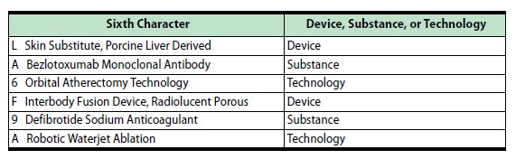
New Technology Section
Character 6: Device/Substance/Technology
The sixth character specifies the key feature of the new technology procedure. It may be specified as a new device, a new substance, or other new technology.
Some examples are-
Character 7: Qualifier
The seventh- character qualifier is used exclusively to specify the new technology group.

Slide 12
General guidelines
E1.a
Section X codes fully represent the specific procedure described in the code title, and do not require additional codes from other sections of ICD-10-PCS. When section X contains a code title which fully describes a specific new technology procedure, and it is the only procedure performed, only the section X code is reported for the procedure. There is no need to report an additional code in another section of ICD-10-PCS.
Example: XW043A6 Introduction of Cefiderocol Anti-infective into Central Vein, Percutaneous Approach, New Technology Group 6, can be coded to indicate that Cefiderocol Anti-infective was administered via a central vein. A separate code from table 3E0 in the Administration section of ICD-10-PCS is not coded in addition to this code.

Slide 13
General guidelines
E1.b
When multiple procedures are performed, New Technology section X codes are coded following the multiple procedures guideline.
Examples: Dual filter cerebral embolic filtration used during transcatheter aortic valve replacement (TAVR), X2A5312 Cerebral Embolic Filtration, Dual Filter in Innominate Artery and Left Common Carotid Artery, Percutaneous Approach, New Technology Group 2, is coded for the cerebral embolic filtration, along with an ICD-10-PCS code for the TAVR procedure.
An extracorporeal flow reversal circuit for embolic neuroprotection placed during a transcarotid arterial revascularization procedure, a code from table X2A, Assistance of the Cardiovascular System is coded for the use of the extracoporeal flow reversal circuit, along with an ICD-10-PCS code for the transcarotid arterial revascularization procedure.

Slide 14
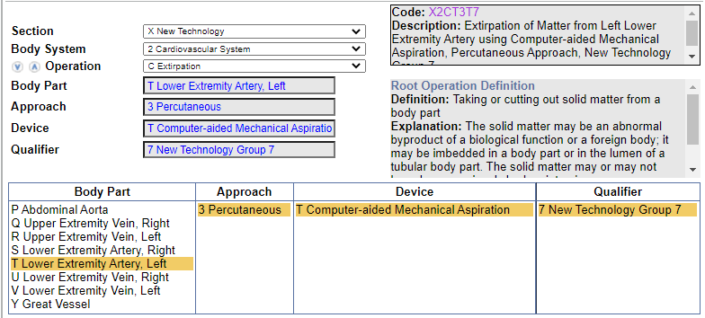
Clinical Example 1
Percutaneous Atherectomy of left femoral artery Calcified Lesion, using computer-aided Mechanic aspiration New Technology 7.
Code: X2CT3T7 (Extirpation of Matter from Left Lower Extremity Artery using Computer-aided Mechanical Aspiration, Percutaneous Approach, New Technology Group 7)
Coding Navigation:

Slide 15
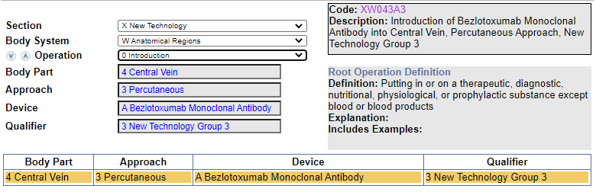

Clinical Example 2
Infusion of Bezlotoxumab Monoclonal Antibody via Central Vein
Code: XW043A3 (Introduction of Bezlotoxumab Monoclonal Antibody into Central Vein, Percutaneous Approach, New Technology Group 3)
Coding Navigation:

Slide 16
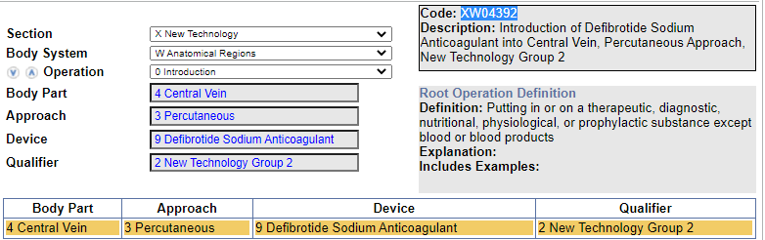

Knowledge Check 1
What is the code assignment for infusion of Defibrotide Sodium Anticoagulant into Central Vein, New Technology Group 2?
Codes: XW04392 (Introduction of Defibrotide Sodium Anticoagulant into Central Vein, Percutaneous Approach, New Technology Group 2)
Code Navigation:

Slide 17
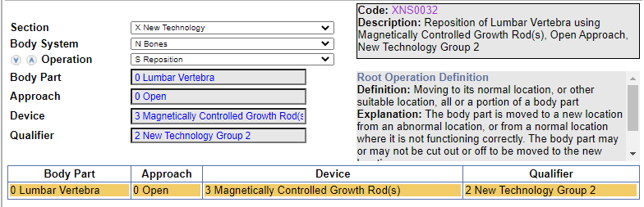
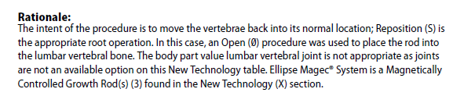
Knowledge Check 2
What is the code assignment for open insertion of Ellipse Magec system into Lumbar vertebra to correct Scoliosis?
Code: XNS0032 (Reposition of Lumbar Vertebra using Magnetically Controlled Growth Rod(s), Open Approach, New Technology Group 2)
Code Navigation:

Slide 18
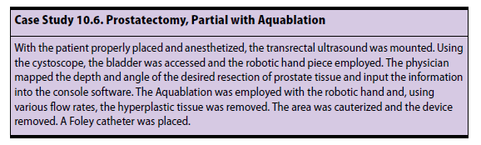
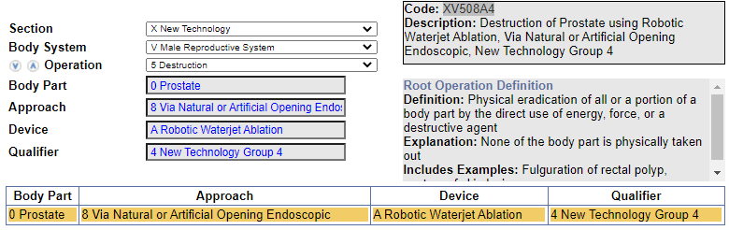
Exercise 1
Code: XV508A4 (Destruction of Prostate using Robotic Waterjet Ablation, Via Natural or Artificial Opening Endoscopic, New Technology Group 4)
Code Navigation:

Slide 19
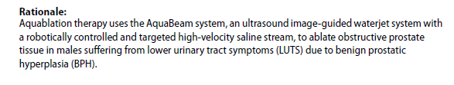
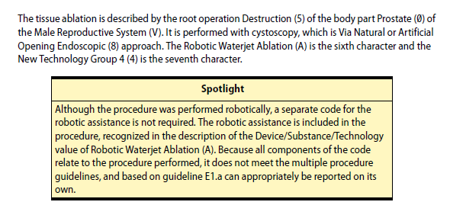

Slide 20

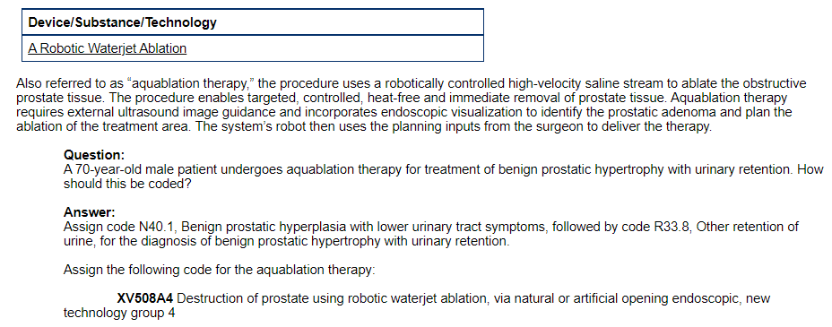
Coding Clinic

Slide 21
Thank You

